Slide 1

IME602: Probability and Statistics-MULTIVARIATE ANALYSIS (01)
Raghu Nandan Sengupta
Industrial & Management Engineering Department
Indian Institute of Technology Kanpur

Slide 2
Multivariate Statistical Analysis (Example # 01)
As a dietician in the hospital one is interested to study the physical features and find out the relevant parameters like body density (BD), body mass index (BMI), etc., of patients who undergo treatment in the hospital.

Slide 3
Multivariate Statistical Analysis (Example # 01 contd..)
Dietician's job is to decide on the right diet plan based on the data/information like percent body fat, age (years), weight (kg), height (cms), etc., of the patients

Slide 4
Multivariate Statistical Analysis (Example # 01 contd..)
Let us use the data <http://wiki.stat.ucla.edu/socr/index.php/SOCR_Data_BMI_Regression> which consists of a sample set of 252 patients, as this enables you to do a detailed study/analysis of the different characteristics, like body fat index, height and weight using 3D scatter plot

Slide 5
Multivariate Statistical Analysis (Example # 01 contd..)

Slide 6
Multivariate Statistical Analysis (Example # 02)
A real estate agent in the state of California (CA), USA, is interested to forecast the median house value (MHV)
He/She has 20,640 data points consisting of information like median house value (MHV), median income (MI), housing median age (HMA), total rooms (TR), total bedrooms (TB), population (P), households (H), etc.

Slide 7
Multivariate Statistical Analysis (Example # 02 contd..)
Information about the data-set can be obtained in the paper titled Sparse Spatial Autoregressions, Pace R. Kelley and Ronald Barry, Statistics and Probability Letters, 1997, 33, 291-297
Let us fit the multiple linear regression (MLR) model (as used by the authors) to this data, then one obtains the ordinary least square (OLS) regression coefficient vector

Slide 8
Multivariate Statistical Analysis (Example # 02 contd..)
β_{e} = (β_{0,e} = 11.4939, β_{1,e} = 0.4790, β_{2,e} = -0.0166, β_{3,e} = -0.0002, β_{4,e} = 0.1570, β_{5,e} = -0.8582, β_{6,e} = 0.8043, β_{7,e} = -0.4077, β_{8,e} = 0.0477), here the suffix e is the estimated value
Thus if one wants to forecast the 20621th reading which is 11.5129255 then the forecasted value is12.3302108 which results in an error of 0.8172853

Slide 9
Multivariate Statistical Analysis (Example # 03)
Consider a faculty member is interested to study the change in the prices of seven stocks, namely Bajaj Auto, Maruti Suzuki Indian Limited, Tata Motors, Steel Authority of India, Tata Steel, Infosys Limited and Tata Consultancy Services Limited, for the time period 01-January-2014 to 31-December-2014

Slide 10
Multivariate Statistical Analysis (Example # 03 contd..)
The faculty member utilizes the prices of these seven stocks from National Stock Exchange (NSE), which is available at <http://in.finance.yahoo.com> or <http://www.nse-india.com>

Slide 11
Multivariate Statistical Analysis (Example # 03 contd..)
A closer look convinces the faculty member that the price movement for the first three scripts, namely (Bajaj Auto, Maruti Suzuki Indian Limited and Tata Motors), the next two (Steel Authority of India and Tata Steel) and the last two (Infosys Limited and Tata Consultancy Services Limited) move in tandem as separate groups as they are from the automobile, steel and information technology sectors respectively.
The surmise, is valid as the companies that are in the same sector tend to vary together as economic conditions change and this fact is also substantiated by the factor analysis

Slide 12
Multivariate Statistical Analysis (Example # 03 contd..)

Slide 13
Multivariate Statistical Analysis
In all these three examples what is important to note is the fact that given a multi-dimension data-set, X _{(n×p)}, of size (n×p), the user, be it the dietician, or the real estate or the faculty member, are all interested to draw some meaningful conclusions from this data-set, X_{(n×p)}.The study of multivariate statistics leads us to analyze multivariate distributions

Slide 14
Multivariate Statistical Analysis
It is interesting to note that Francis Galton (1822-1911) may be credited as the first person who worked in the area of multivariate statistical analysis. In his work Natural Inheritance, Macmillan and Company (1889), the author summarized the ideas of regression considering bi-variate normal distribution.

Slide 15
Multivariate Statistical Analysis
To start with, let us define X_{(n×p)}=(X₁,…,X_{p}) or (X_{(i,j)}), i=1,….,n and j=1,…,p as a (n×p) dimension matrix of random variables, where n signifies the number of readings, while p the dimension, corresponds to different factors in a random variable which are of interest to us.

Slide 16
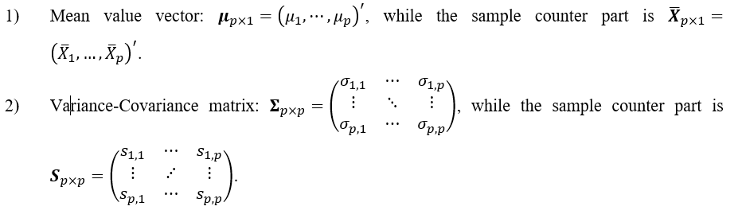
Multivariate Statistical Analysis
(Important Definitions)

Slide 17
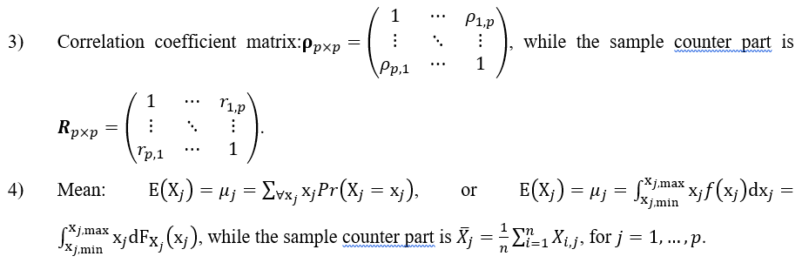
Multivariate Statistical Analysis
(Important Definitions contd…)

Slide 18
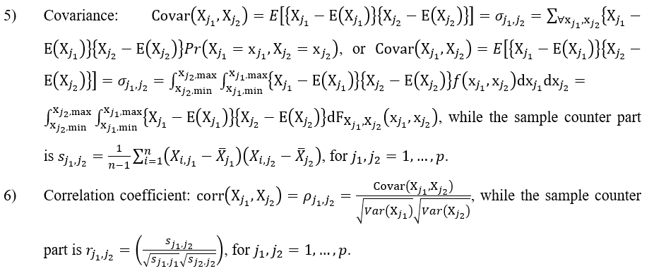
Multivariate Statistical Analysis
(Important Definitions contd…)

Slide 19
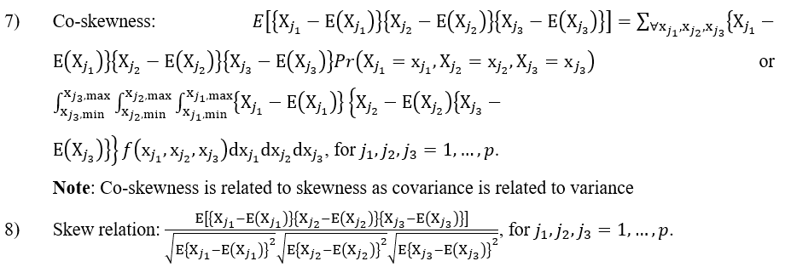
Multivariate Statistical Analysis
(Important Definitions contd…)

Slide 20
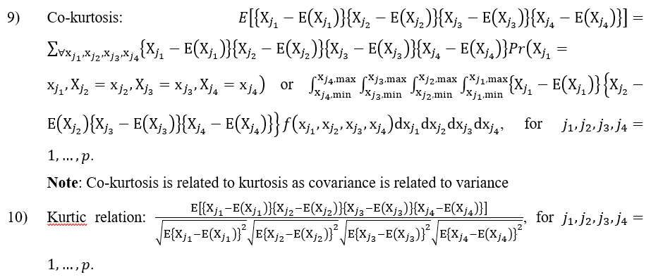
Multivariate Statistical Analysis
(Important Definitions contd…)

Slide 21
Multivariate Statistical Analysis (Example # 04)
Consider the data related to cigarettes given in Statistics for Engineering and the Sciences, William Mendenhall and Terry Sincich, Pearson Publication, 2006, ISBN: 978-0131877061. The dataset contains measurements related to brand, tar content (mg), nicotine content (mg), weight (g) and carbon monoxide content (mg) for n=25 brands of cigarettes. The dataset can be accessed at <http://www.amstat.org/publications/jse/datasets/cigarettes.dat.txt>

Slide 22
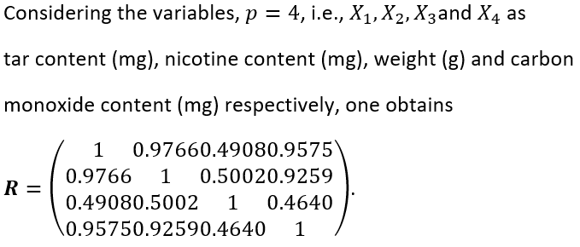
Multivariate Statistical Analysis (Example # 04 contd…)

Slide 23
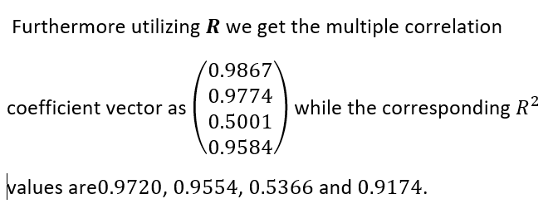
Multivariate Statistical Analysis (Example # 04 contd…)

Slide 24
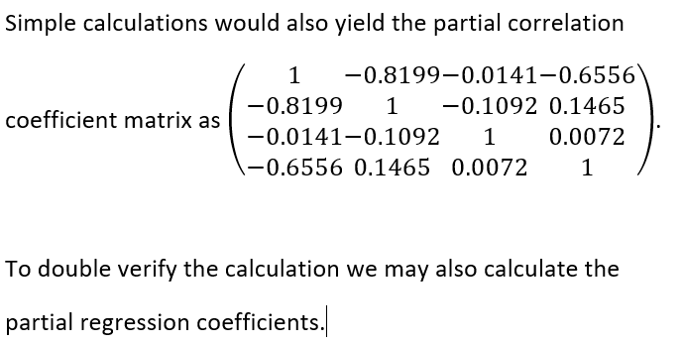
Multivariate Statistical Analysis (Example # 04 contd…)

Slide 25
Multinomial distribution
Suppose X₁,…,X_{p} be p jointly distributed random variable each of which is discrete, non-negative and integer valued
Then the joint probability mass function of X₁,…,X_{p} is called the multinomial distribution and is of the form ^{n}C_{x1,…,xp}*p₁^{x1} *…… *p_{p}^{xp}

Slide 26
Multinomial distribution (contd..)
For a better appreciation of the multinomial distribution consider the polynomial coefficients of the expansion of the multinomial expansion, {p_{1x1}+⋯.+p_{pxp}}^{n}

Slide 27
Multinomial distribution (contd..)
A closer look at this expansion will make it immediately evident how the polynomial coefficients of the multinomial expansion correspond to the multinomial distribution discussed above. Another interesting analogy for multinomial distribution can be made from the Pascal Pyramid

Slide 28
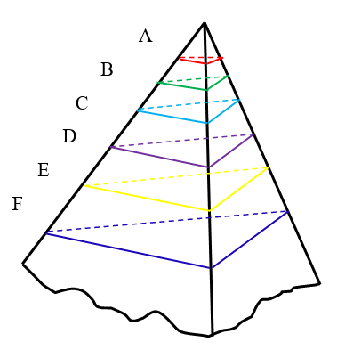
Multivariate Statistical Analysis
(Multinomial distribution contd..)

Slide 29
Multivariate Statistical Analysis
(Multinomial distribution contd..)
If we view the slices (as represented by A, B, C, D, E, F and so on) of the Pascal Pyramid as flat triangular plates, then the numbers depicted on them are as follows

Slide 30
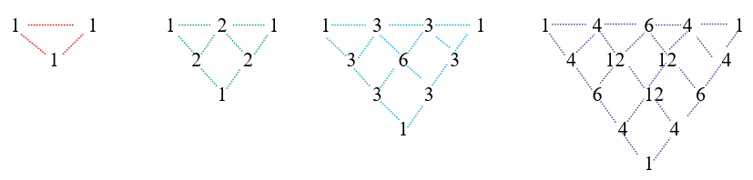
Multivariate Statistical Analysis
(Multinomial distribution contd..)

Slide 31
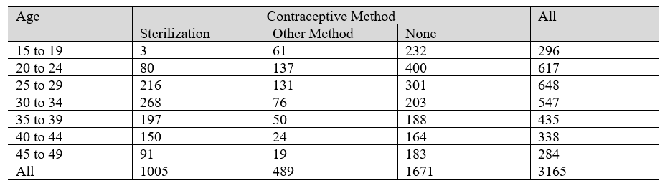
Multivariate Statistical Analysis
(Multinomial distribution Example # 05)
Consider the use of contraceptive amongst married women in El Salvador in 1985, and the data for the same for a sample of 3165 respondents is shown

Slide 32
Multivariate Statistical Analysis
(Multinomial distribution Example # 05 contd..)
Consider X₁, X₂ and X₃ as the random variable signifying the case of sterilization, other method and none. Then the joint multinomial distribution may be written as f_{X1},_{X2},_{X3}(x₁,x₂,x₃)=Pr(X₁=x₁,X₂=x₂,X₃=x₃)=^{n}C_{x1,x2,x3}*(1005/3165)^{x1}*(489/3165)^{x2}*(1005/3165)^{x3}, where x₁+x₂+x₃=n

Slide 33
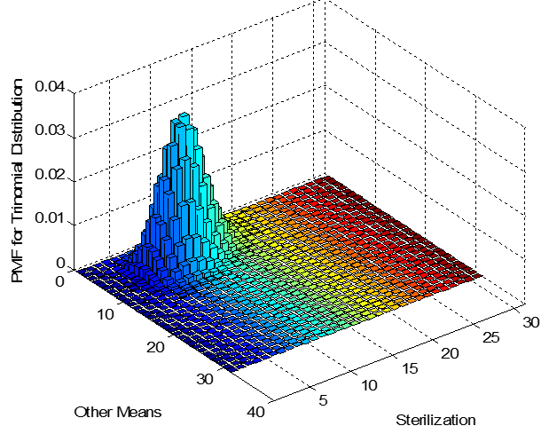
Multivariate Statistical Analysis
(Multinomial distribution Example # 05 contd..)

Slide 34
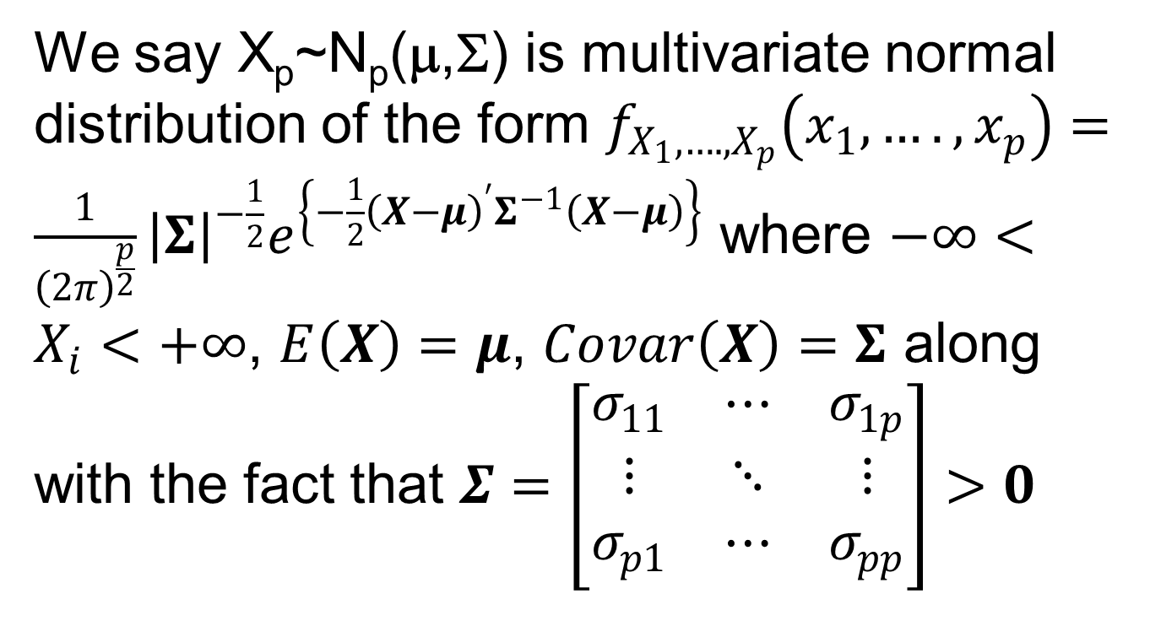
Multivariate Normal Distribution

Slide 35
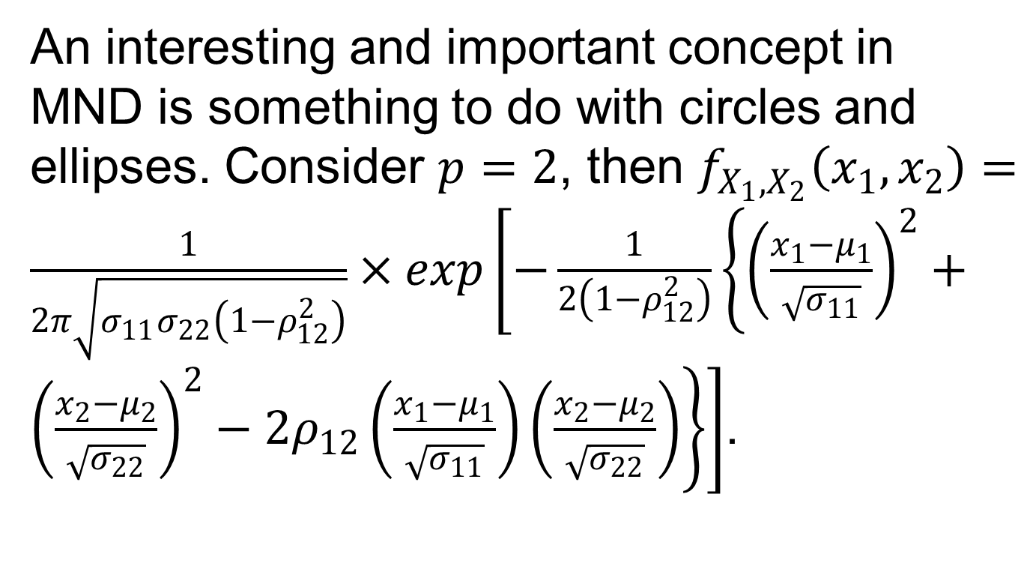
Multivariate Normal Distribution (contd..)

Slide 36
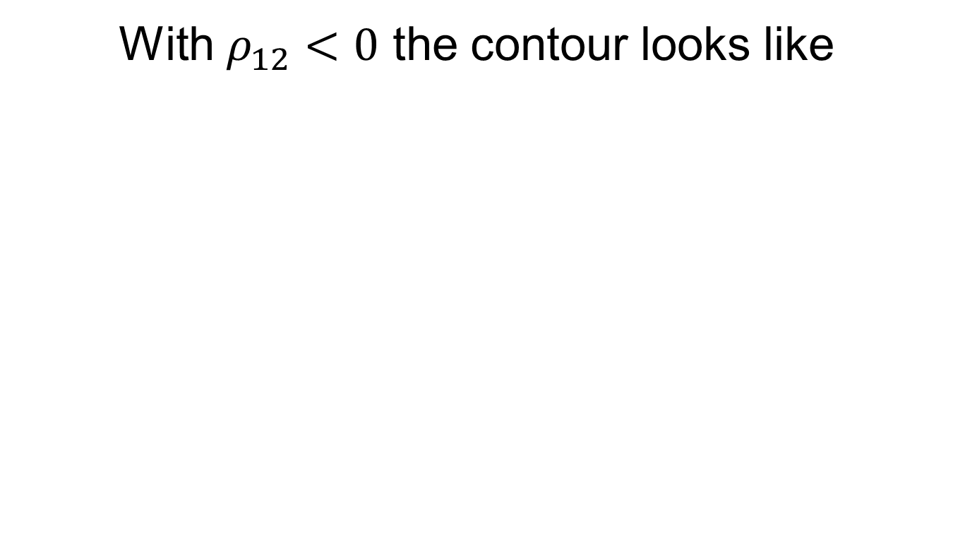
Bivariate Normal Distribution

Slide 37
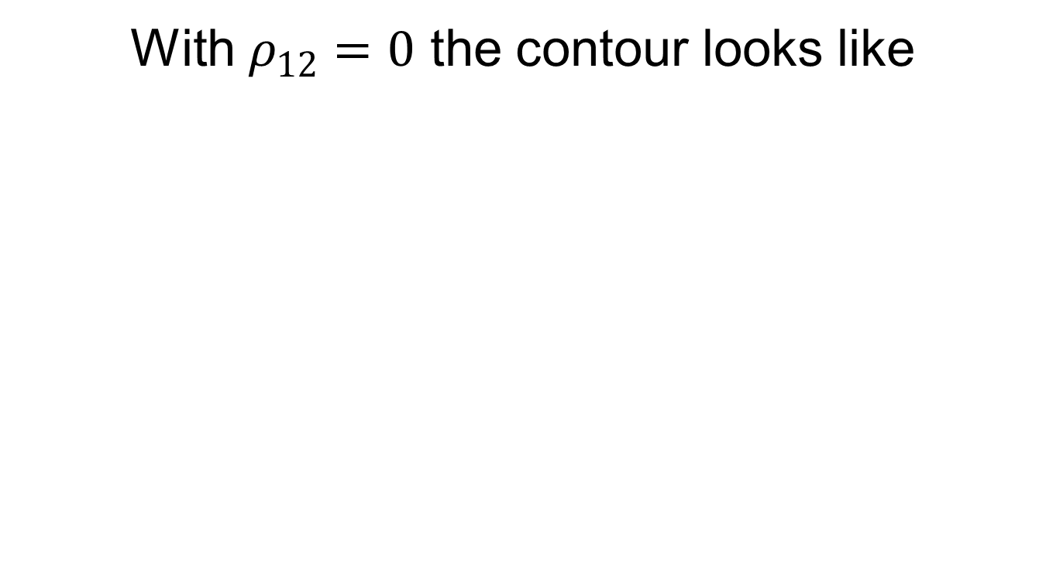
Bivariate Normal Distribution (contd..)

Slide 38
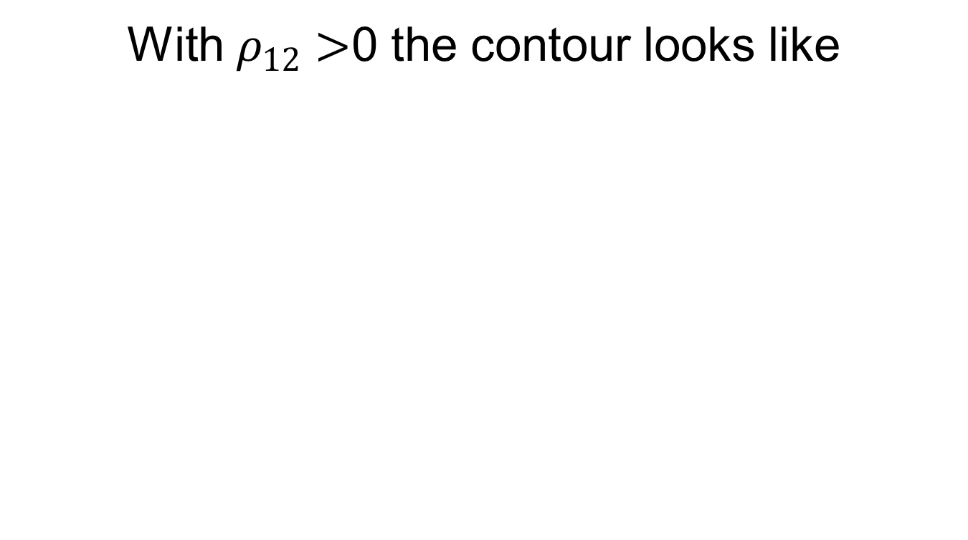
Bivariate Normal Distribution (contd..)

Slide 39
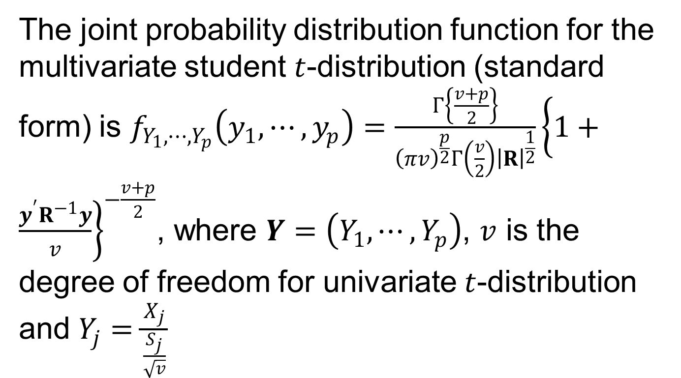
Multivariate Student t-Distribution

Slide 40
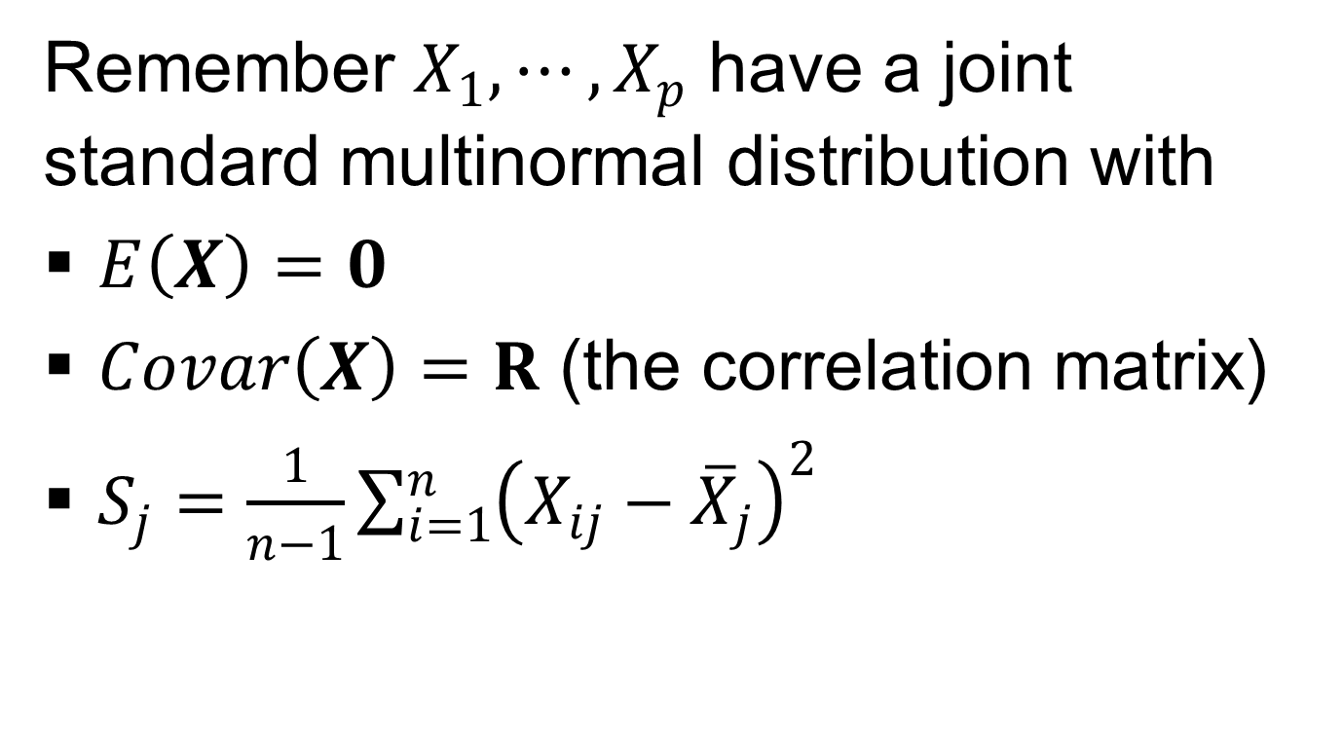
Multivariate Student t-Distribution (contd..)

Slide 41
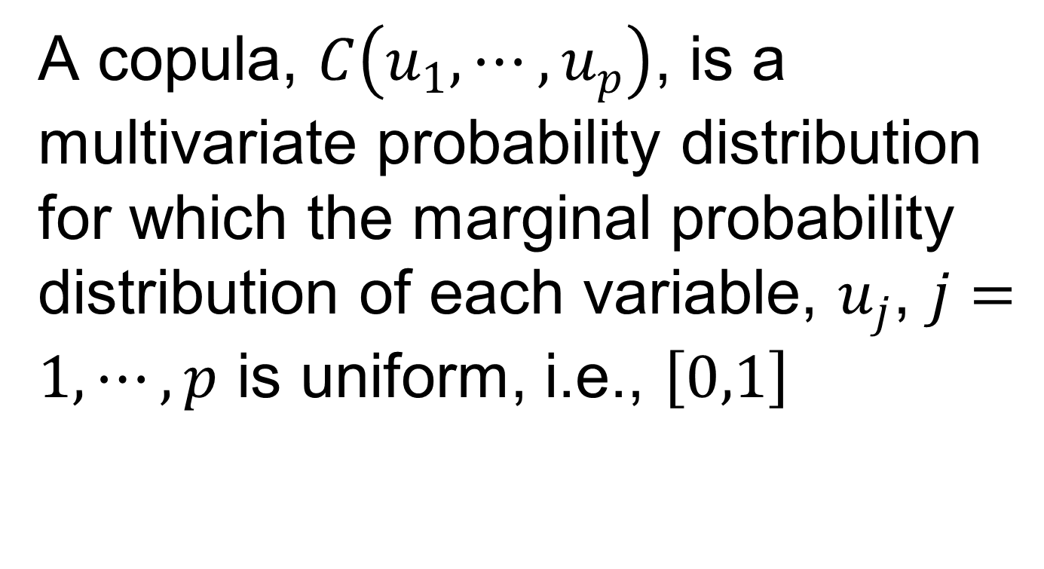
Multivariate Distribution (Copula)

Slide 42
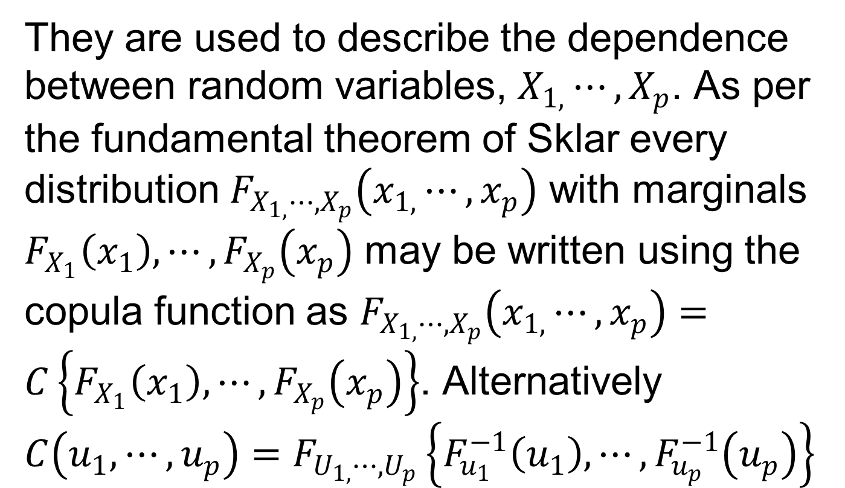
Multivariate Distribution (Copula) (contd..)

Slide 43
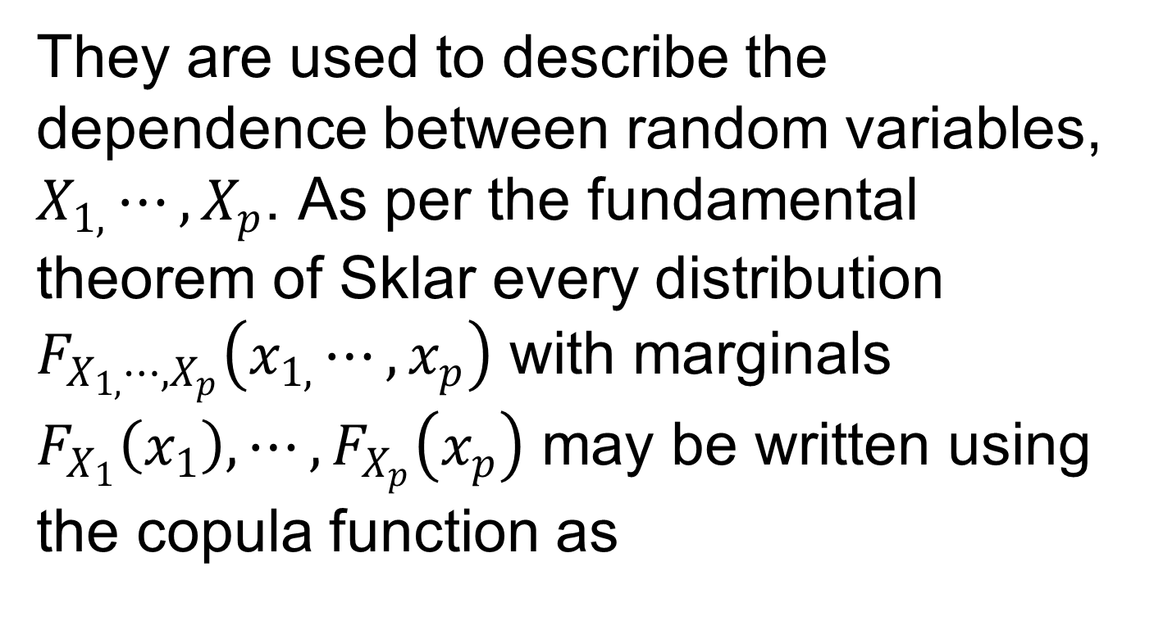
Multivariate Distribution (Copula) (contd..)

Slide 44
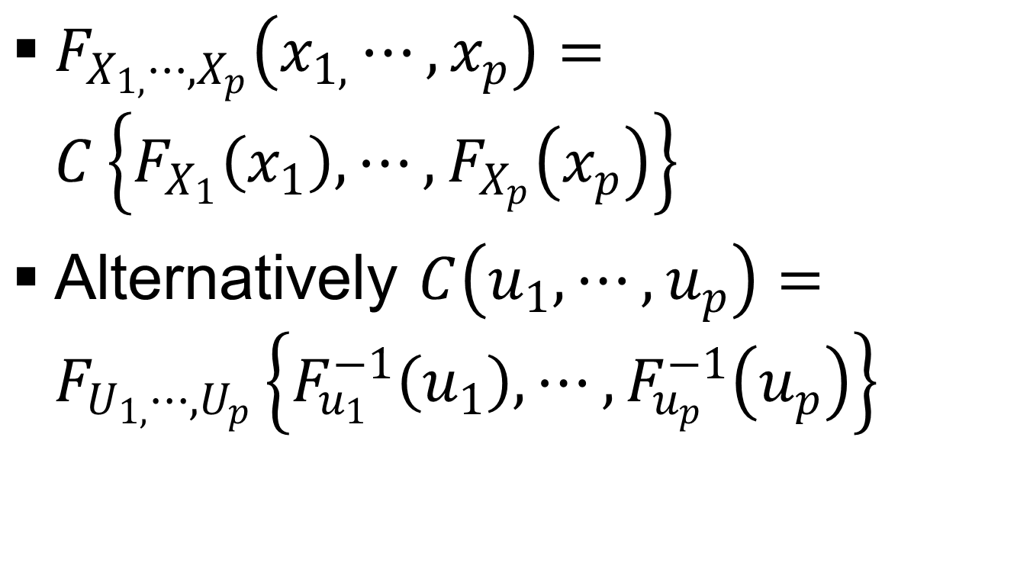
Multivariate Distribution (Copula) (contd..)

Slide 45

Multivariate Distribution (Copula) (Example # 05)

Slide 46
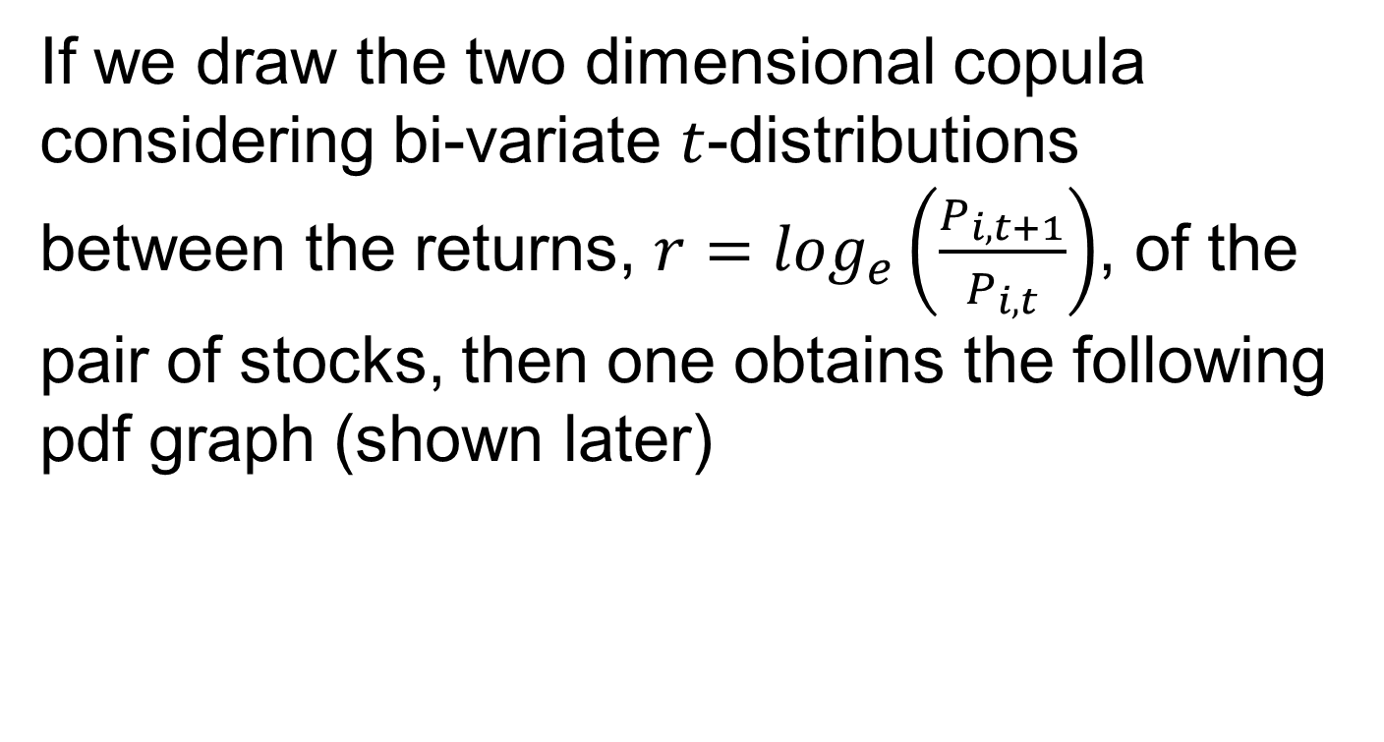
Multivariate Distribution (Copula) (Example # 05) (contd..)

Slide 47
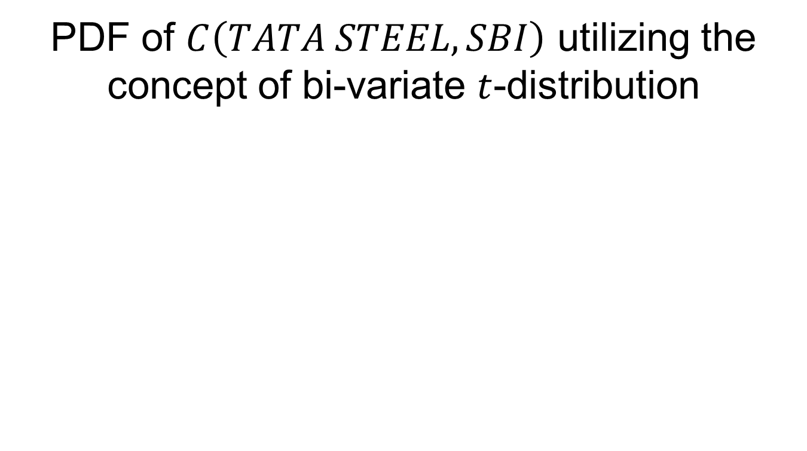
Multivariate Distribution (Copula) (Example # 05)

Slide 48
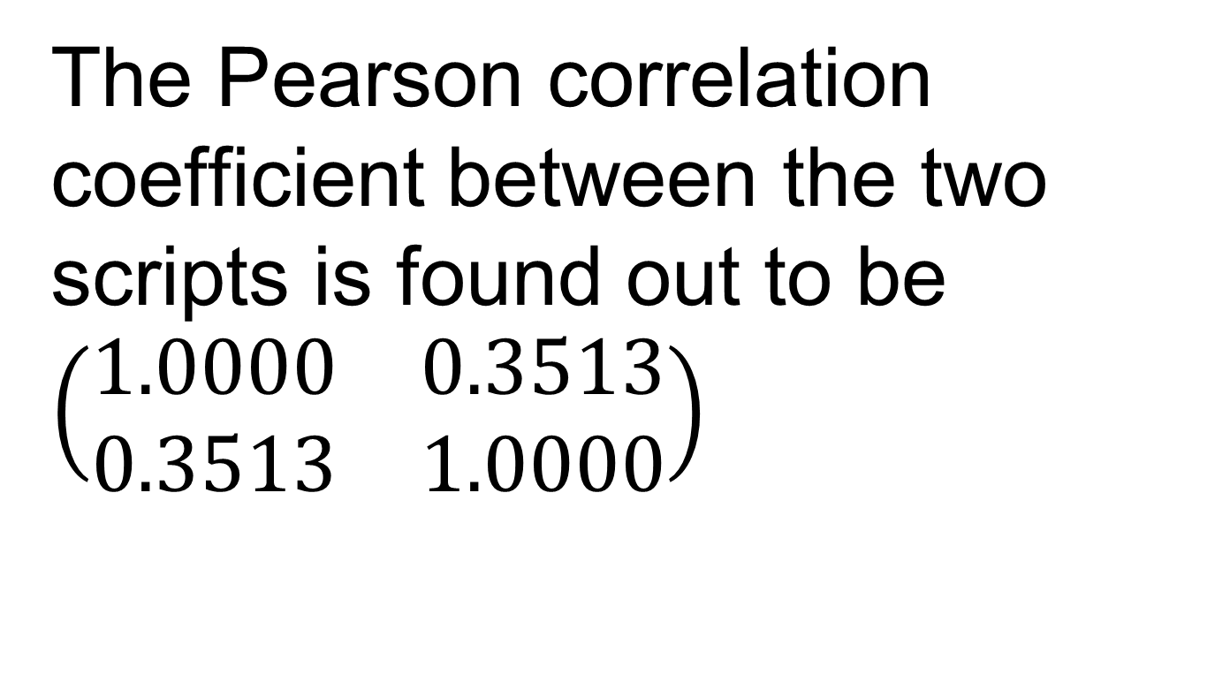
Multivariate Distribution (Copula) (Example # 05) (contd..)

Slide 49
Wishart Distribution
Wishart distribution is a generalization of the chi-squared distribution in the multiple dimensions. It was first formulated by John Wishart (1898-1956), Wishart (1928).

Slide 50
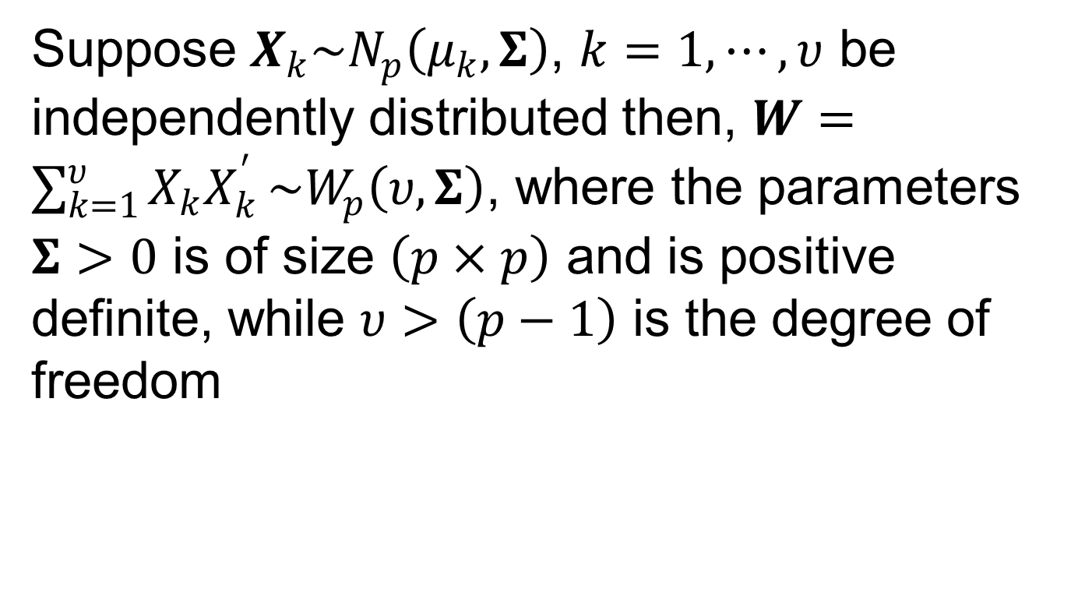
Wishart Distribution (contd..)

Slide 51
Wishart Distribution (contd..)
The Wishart distribution arises as the distribution of the sample covariance matrix for a sample from a multivariate normal distribution

Slide 52
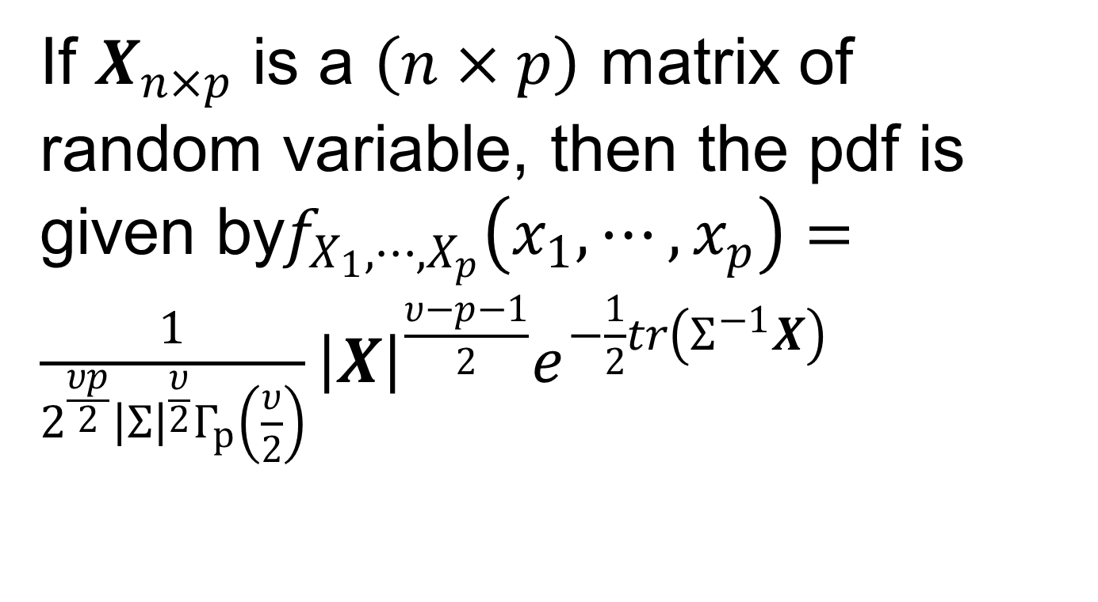
Wishart Distribution (contd..)

Slide 53
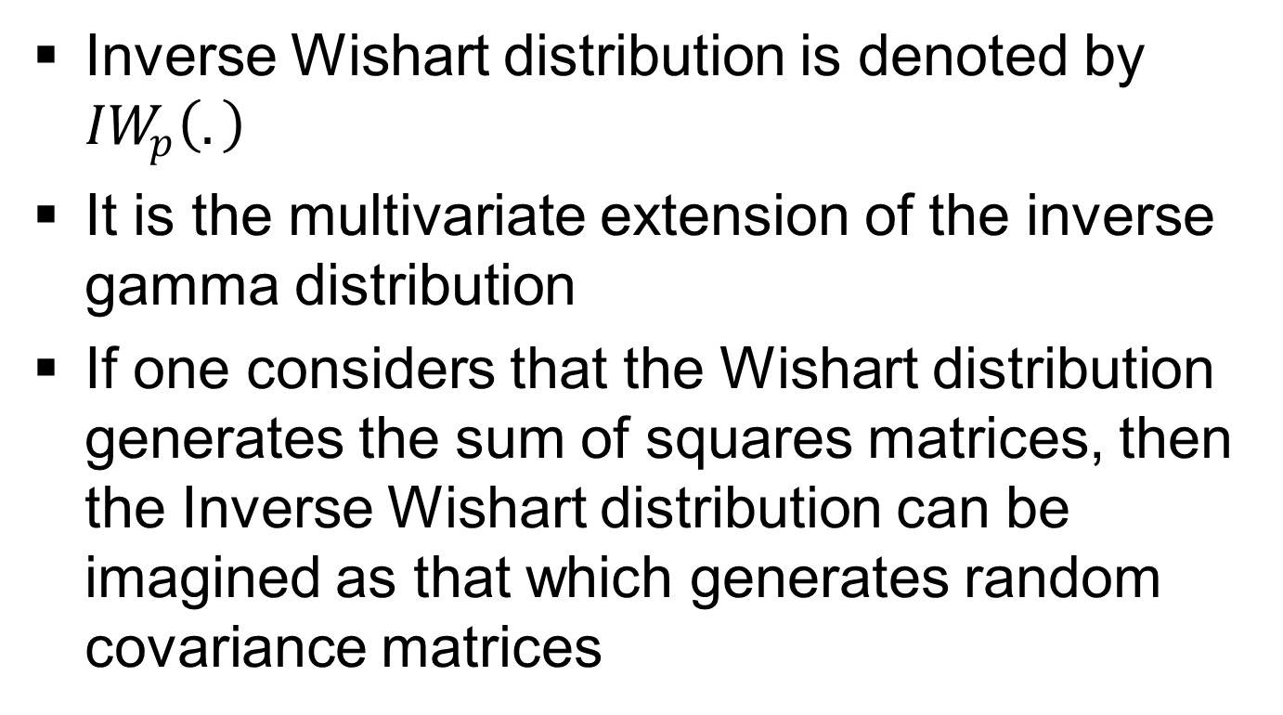
Inverse Wishart Distribution

Slide 54
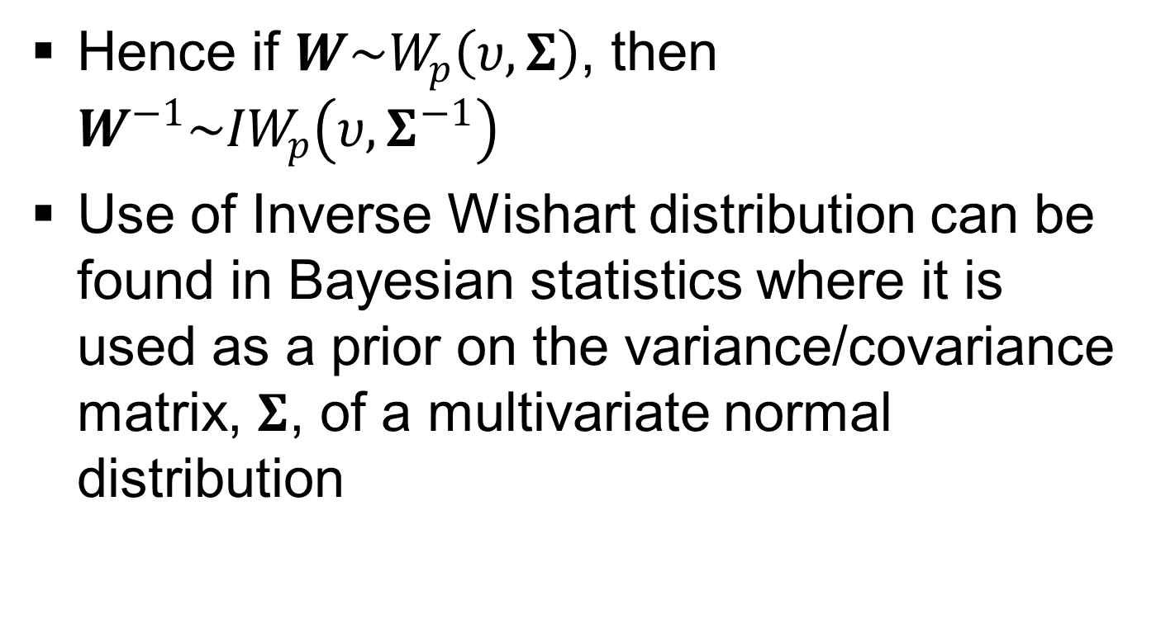
Inverse Wishart Distribution (contd..)

Slide 55
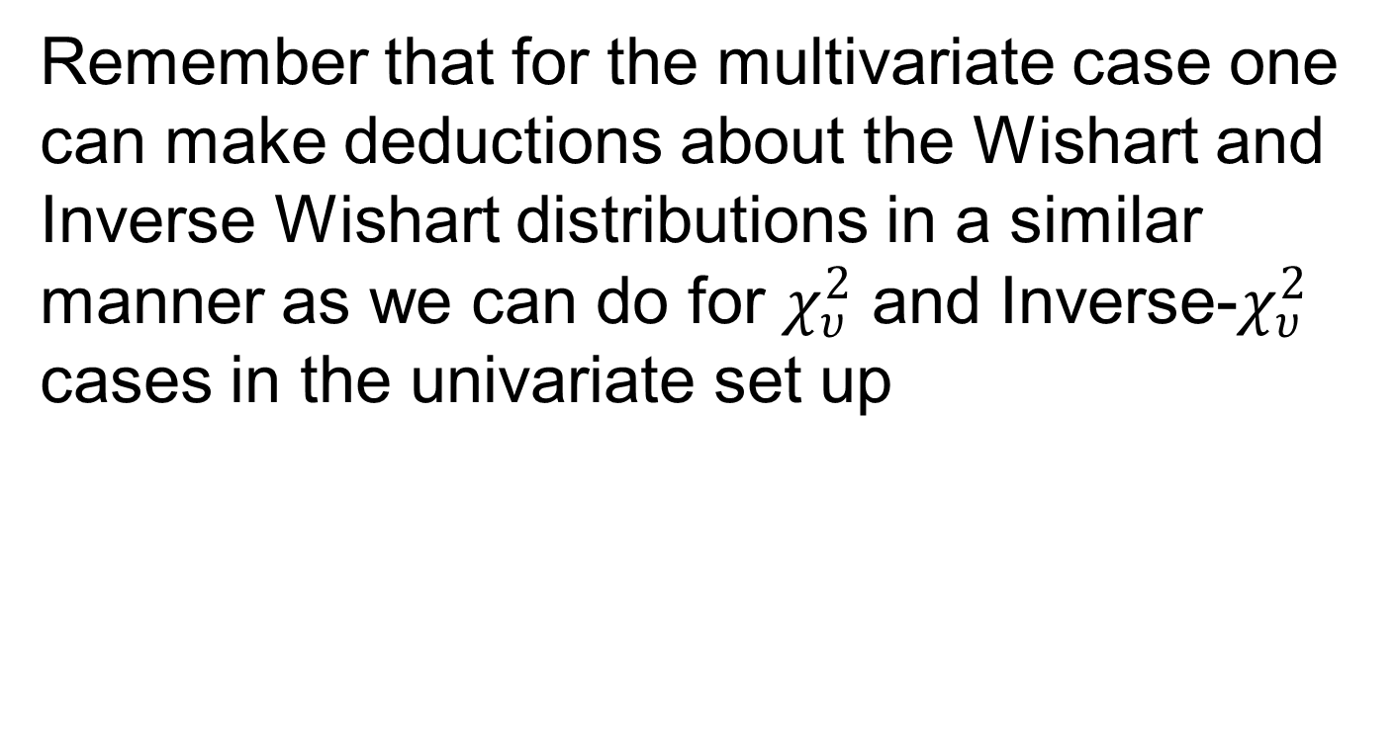
Wishart & Inverse Wishart Distributions

Slide 56

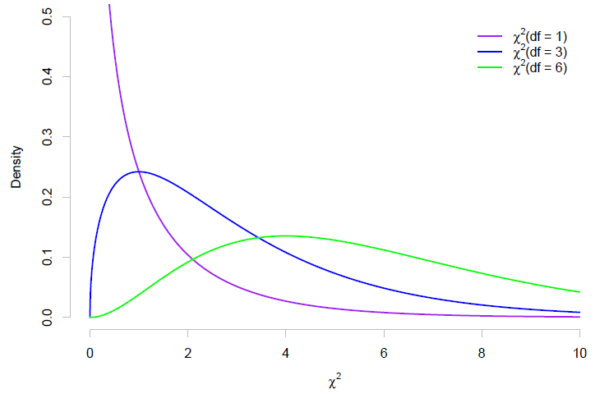

Slide 57
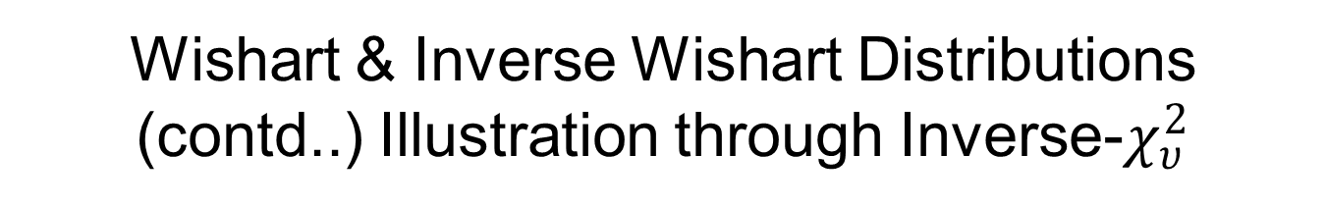
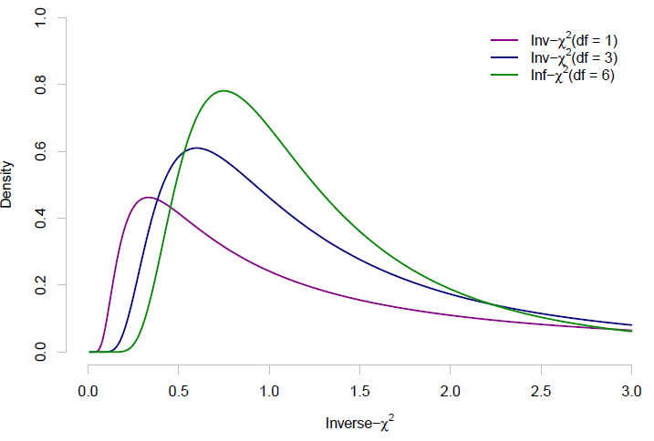

Slide 58
Multivariate Extreme Value Distribution (MEVD)
Multivariate extreme gives us the picture of the asymptotic behavior of component wise maxima of i.i.d observations
The main problem one faces is how to define multivariate extreme value distribution (MEVD)
This problem arises due to the fact that there does not exist any strict ordering principle for multivariate observations

Slide 59
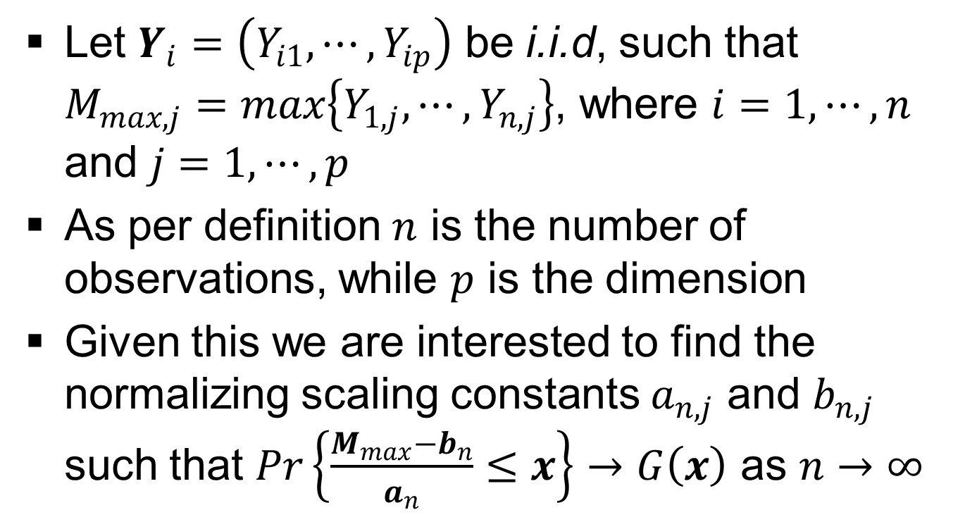
Multivariate Extreme Value Distribution (MEVD) (contd..)

Slide 60
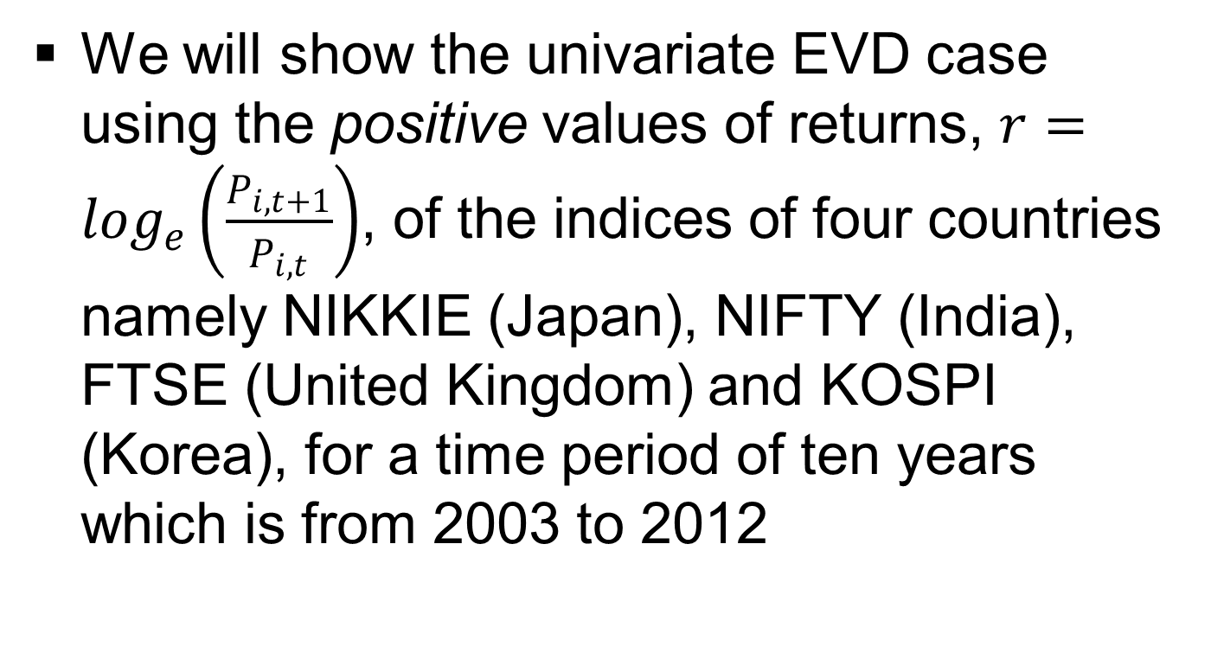
Multivariate Extreme Value Distribution (MEVD) (contd..)

Slide 61
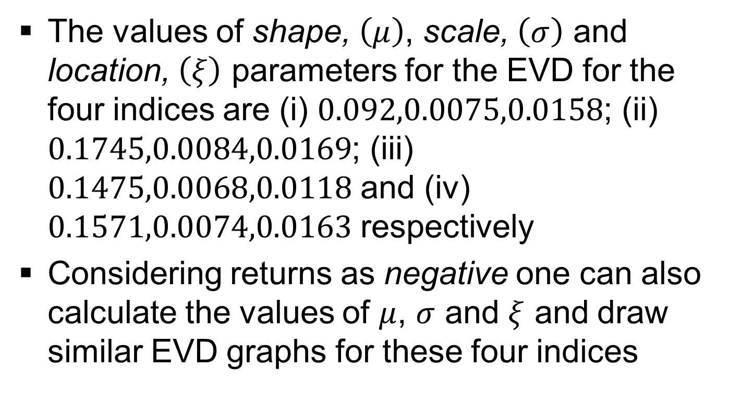
Multivariate Extreme Value Distribution (MEVD) (contd..)

Slide 62
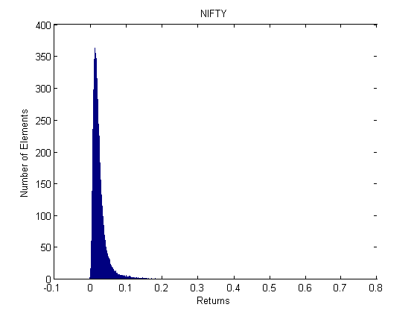
Multivariate Extreme Value Distribution (MEVD) Illustration
PDF of NIFTY

Slide 63
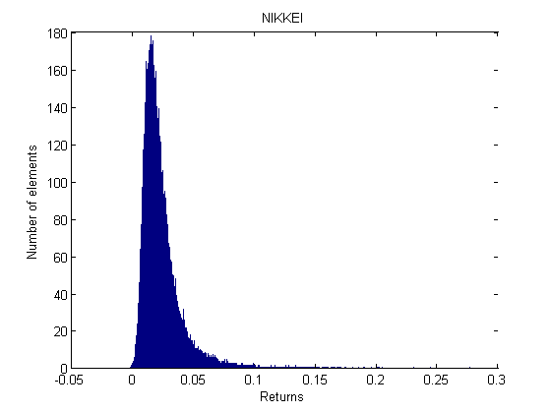
Multivariate Extreme Value Distribution (MEVD) Illustration
PDF of NIKKIE

Slide 64
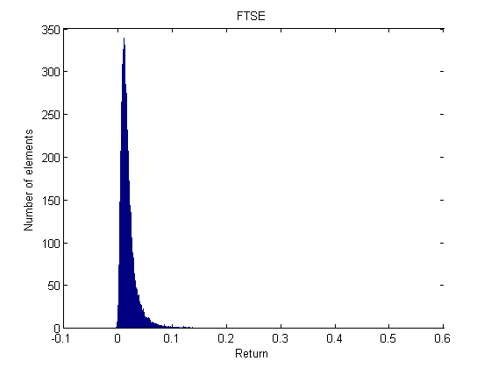
Multivariate Extreme Value Distribution (MEVD) Illustration
PDF of FTSE

Slide 65
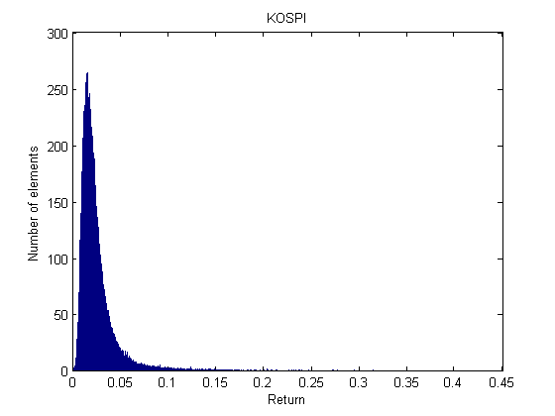
Multivariate Extreme Value Distribution (MEVD) Illustration
PDF of KOSPI

Slide 66
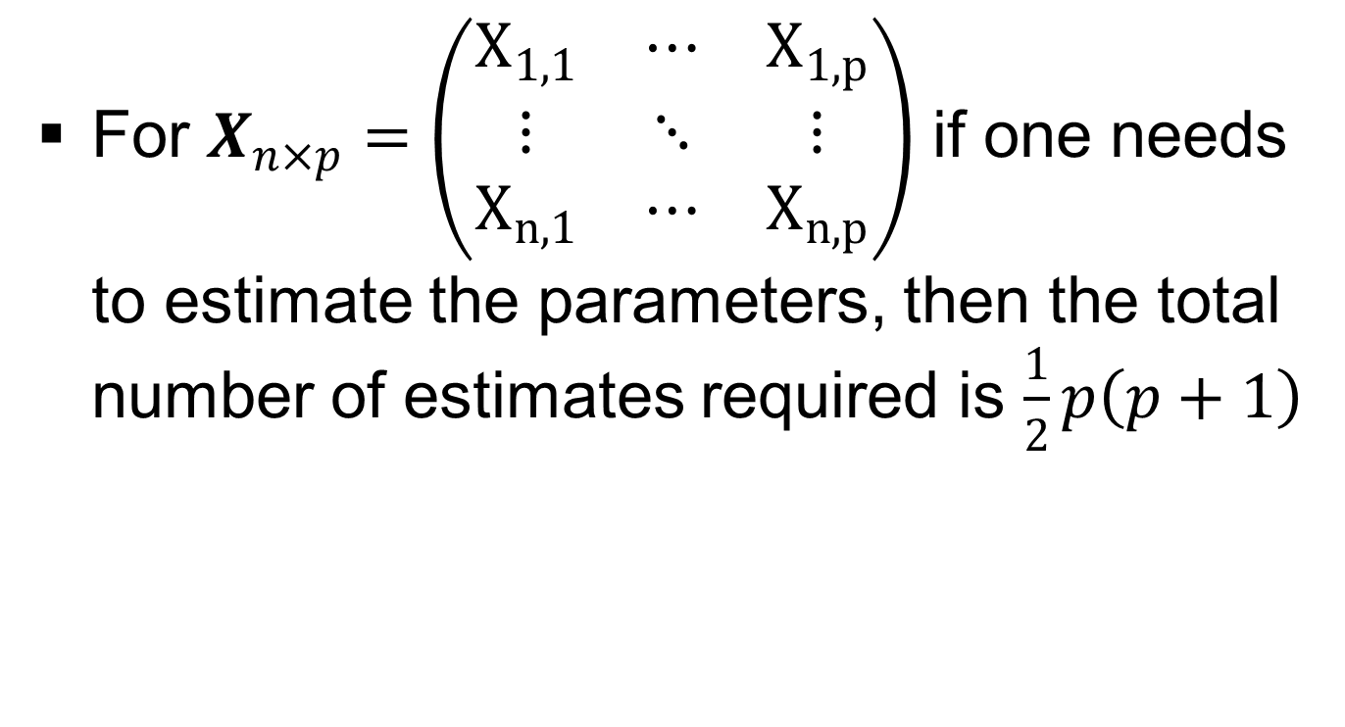
MLE estimates of parameters(related to MND only)

Slide 67
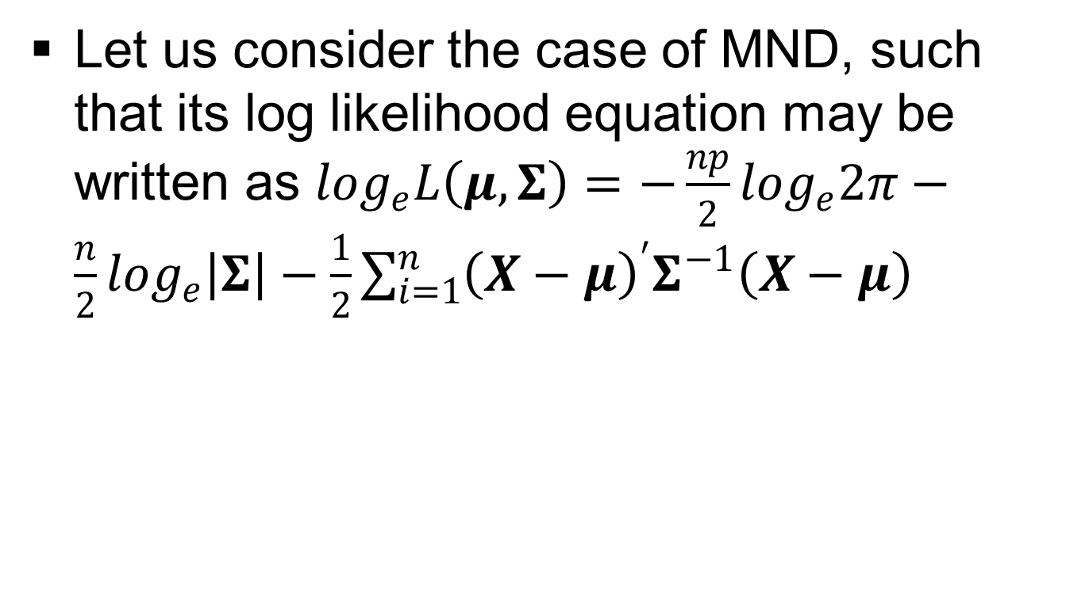
MLE estimates of parameters(related to MND only) (contd..)

Slide 68
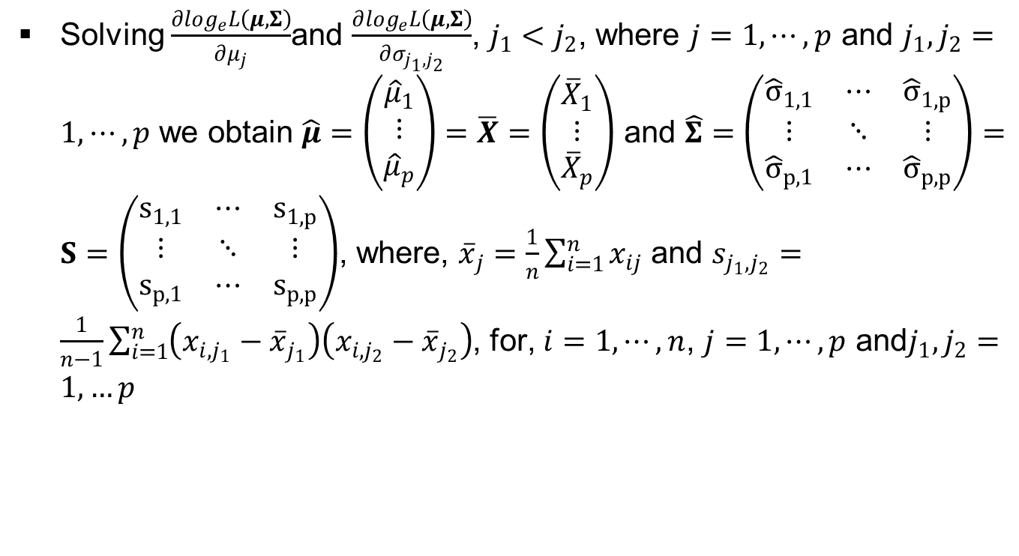
MLE estimates of parameters(related to MND only) (contd..)

Slide 69
MLE estimates of parameters(related to MND only) (contd..)
Let us now suppose the case of hypothesis testing. Few relevant results without proofs for the same can be stated as follows

Slide 70
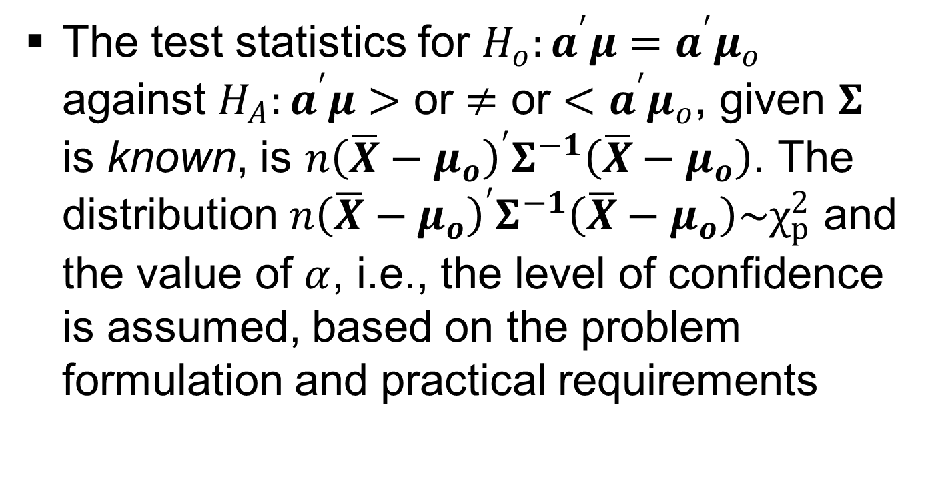
MLE estimates of parameters(related to MND only) (contd..)

Slide 71
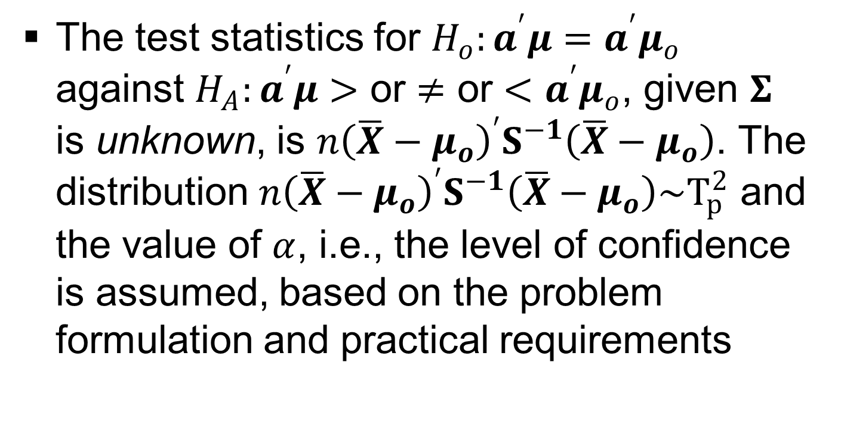
MLE estimates of parameters(related to MND only) (contd..)

Slide 72
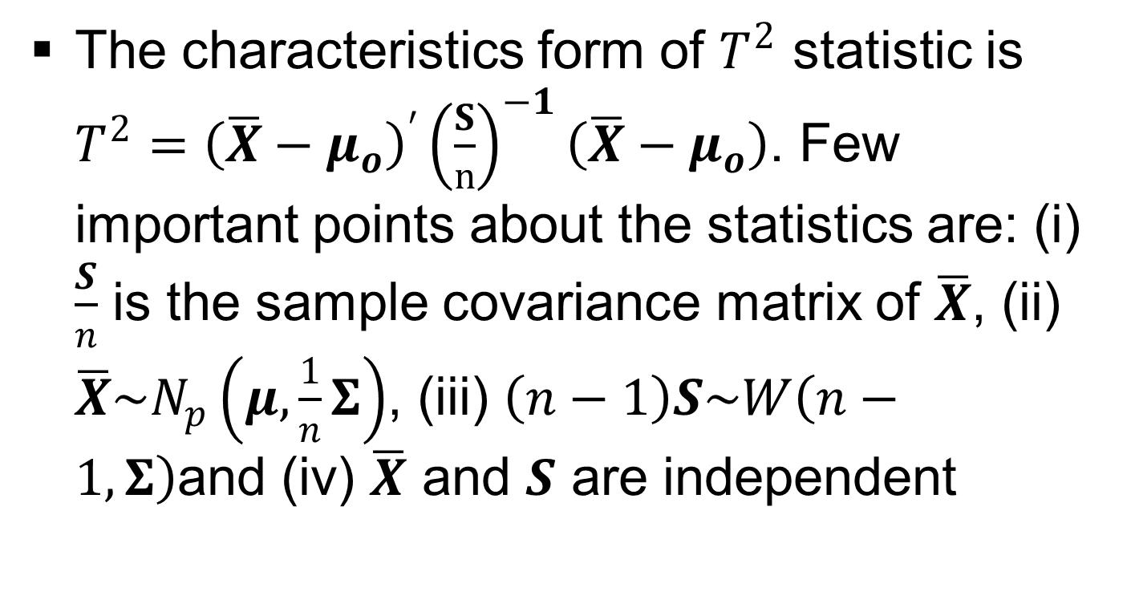
MLE estimates of parameters(related to MND only) (contd..)

Slide 73
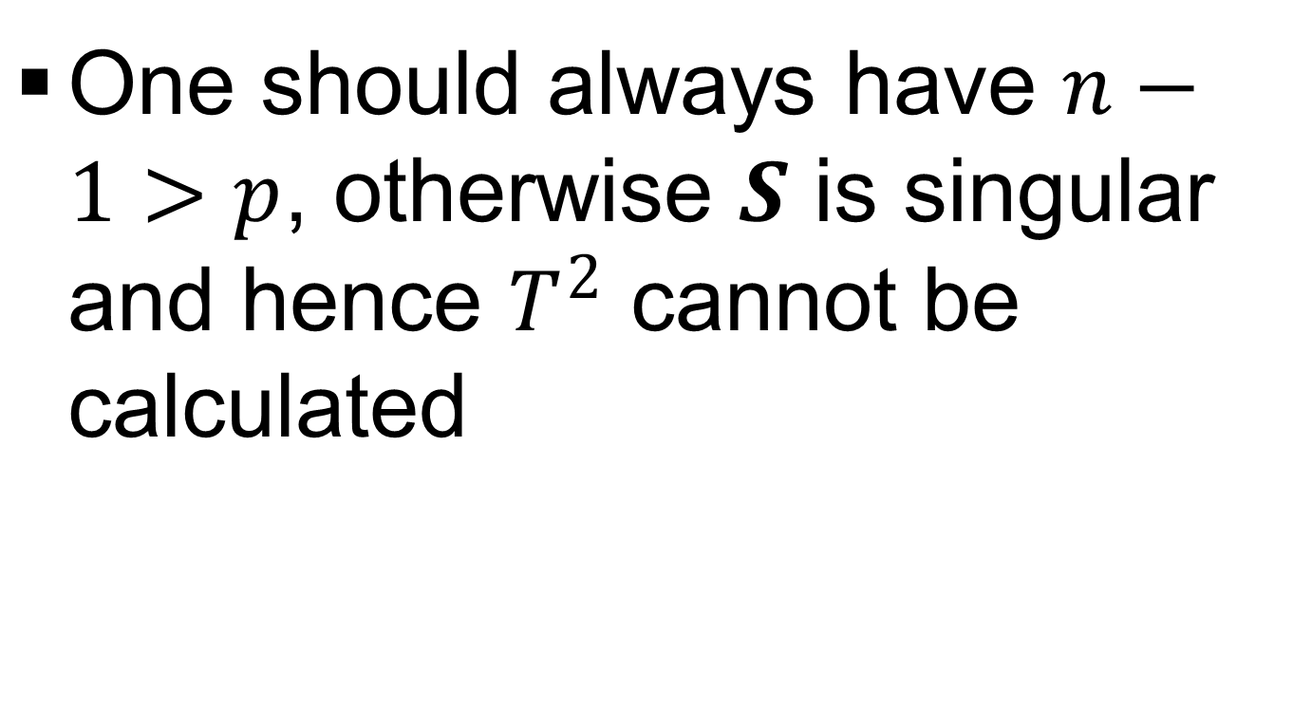
MLE estimates of parameters(related to MND only) (contd..)

Slide 74
MLE estimates of parameters(related to MND only) (contd..)
Using the property of sufficiency and the concept of factorization we obtain the following results which we state, again without any proofs

Slide 75
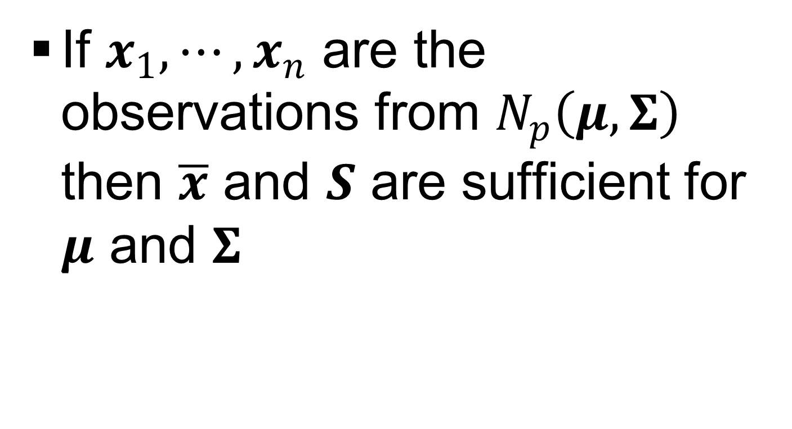
MLE estimates of parameters(related to MND only) (contd..)

Slide 76
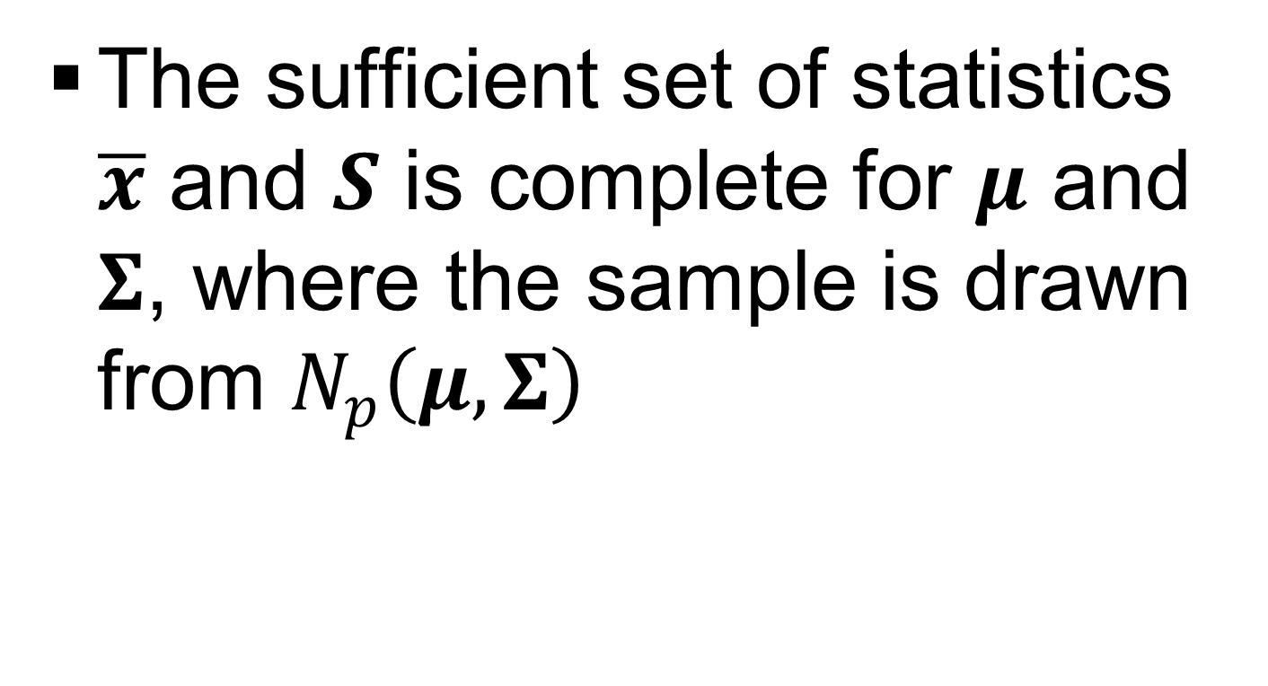
MLE estimates of parameters(related to MND only) (contd..)

Slide 77

MLE estimates of parameters(related to MND only) (contd..)

Slide 78

Copula

Slide 79
Copula (contd..)

Slide 80
Copula (contd..)
But in general, most random variables are not jointly elliptically distributed (normal is a class of elliptical distributions) and using linear correlation as a measure of dependence in such situations might prove very misleading

Slide 81

Copula (contd..)

Slide 82

Copula (contd..)

Slide 83

Copula (contd..)

Slide 84
Principal Component Analysis (PCA)
Principal Component Analysis (PCA) is a multivariate ordination technique used to display patterns in multivariate data
It aims to graphically display the relative positions of data points in fewer dimensions while retaining as much information as possible, and also explore relationships between dependent variables

Slide 85
Principal Component Analysis (PCA) (contd..)
It is a hypothesis-generating technique that is intended to describe patterns in a data table, rather than test formal statistical hypotheses
PCA assumes linear responses of variables and has a range of applications other than data display including multiple regression, and variable reduction

Slide 86
Principal Component Analysis (PCA) (contd..)
The main purpose of PCA is to reduce the dimensionality of multivariate data to make its structure clearer
It does this by looking for the linear combination of the variables which accounts for as much as possible of the total variation in the data

Slide 87
Principal Component Analysis (PCA) (contd..)
It then goes on to look for a second combination, uncorrelated with the first, which accounts for as much of the remaining variation as possible and so on
If the greater part of the variation is accounted for by a small number of components, then they may be used in place of the original variables

Slide 88

Principal Component Analysis (PCA) (contd..)

Slide 89

Principal Component Analysis (PCA) (contd..)

Slide 90

Principal Component Analysis (PCA) (contd..)

Slide 91

Principal Component Analysis (PCA) (contd..)

Slide 92

Principal Component Analysis (PCA) (contd..)

Slide 93

Principal Component Analysis (PCA) (contd..)

Slide 94

Principal Component Analysis (PCA) (contd..)

Slide 95

Principal Component Analysis (PCA) (contd..)

Slide 96

Principal Component Analysis (PCA) (contd..)

Slide 97

Principal Component Analysis (PCA) (contd..)

Slide 98

Principal Component Analysis (PCA) (contd..)

Slide 99
Principal Component Analysis (PCA) (contd..)

Slide 100

Principal Component Analysis (PCA) (contd..)

Slide 101

Principal Component Analysis (PCA) (contd..)

Slide 102

Principal Component Analysis (PCA) (contd..)

Slide 103

Principal Component Analysis (PCA) (contd..) (Example # 06)

Slide 104

Principal Component Analysis (PCA) (contd..) (Example # 06)

Slide 105

Principal Component Analysis (PCA) (contd..) (Example # 06)

Slide 106

Principal Component Analysis (PCA) (contd..) (Example # 06)

Slide 107

Principal Component Analysis (PCA) (contd..) (Example # 06)

Slide 108

Principal Component Analysis (PCA) (contd..) (Example # 06)

Slide 109

Principal Component Analysis (PCA) (contd..) (Example # 06)

Slide 110
Factor Analysis (FA)
The origins of factor analysis (FA) may be traced back to the work of Pearson (1901) and Spearman (1904

Slide 111
Factor Analysis (FA) (contd..)
The term FA as we know today was first introduced by Thurstone (1931)
It is a multivariate statistical method based on a model when the observed vector is partitioned into an unobserved systematic part and an unobserved error part

Slide 112
Factor Analysis (FA) (contd..)
The components of the error vector are considered as uncorrelated or independent, while the systematic part is taken as a linear combination of a relatively smaller number of unobserved factor variables

Slide 113
Factor Analysis (FA) (contd..)
Using FA one can separate the effects of the factors (which are of primary interest to us) from the errors
Stated explicitly using FA we intend to partition variables into particular groups such that within a particular group they are highly correlated amongst themselves

Slide 114
Factor Analysis (FA) (contd..)
Moreover these variables have relatively small correlations with variables in a different group
Thus each group of variables represents a single underlying construct/factor that is responsible to give information about the observed correlations

Slide 115
Factor Analysis (FA) (contd..)
In statistical literature we have two methods for estimating the parameters in FA and they are: (i) principal component method and (ii) maximum likelihood method

Slide 116

Factor Analysis (FA) (PCM)

Slide 117

Factor Analysis (FA) (PCM) (contd..)

Slide 118

Factor Analysis (FA) (PCM) (contd..)

Slide 119

Factor Analysis (FA) (PCM) (contd..)

Slide 120

Factor Analysis (FA) (PCM) (contd..)

Slide 121

Factor Analysis (FA) (PCM) (contd..)

Slide 122

Factor Analysis (FA) (PCM) (contd..)

Slide 123

Factor Analysis (FA) (PCM) (contd..)

Slide 124

Factor Analysis (FA) (PCM) (contd..)

Slide 125

Factor Analysis (FA) (PCM) (contd..)

Slide 126

Factor Analysis (FA) (General Working Plan)

Slide 127

Factor Analysis (FA) (General Working Plan) (contd..)

Slide 128

Factor Analysis (FA) (General Working Plan) (contd..)

Slide 129
Factor Analysis (FA) (General Working Plan) (contd..)
Perform factor rotation to a terminal solution

Slide 130

Factor Analysis (FA) (General Working Plan) (contd..)

Slide 131

Factor Analysis (FA) (General Working Plan) (contd..)

Slide 132

Factor Analysis (FA) (General Working Plan) (Example # 07)

Slide 133

Factor Analysis (FA) (General Working Plan) (Example # 07) (contd..)

Slide 134

Factor Analysis (FA) (General Working Plan) (Example # 07) (contd..)

Slide 135

Factor Analysis (FA) (General Working Plan) (Example # 07) (contd..)

Slide 136

Factor Analysis (FA) (General Working Plan) (Example # 07) (contd..)

